Slide 1
SAP Presentation
Accounts Receivable

Slide 2
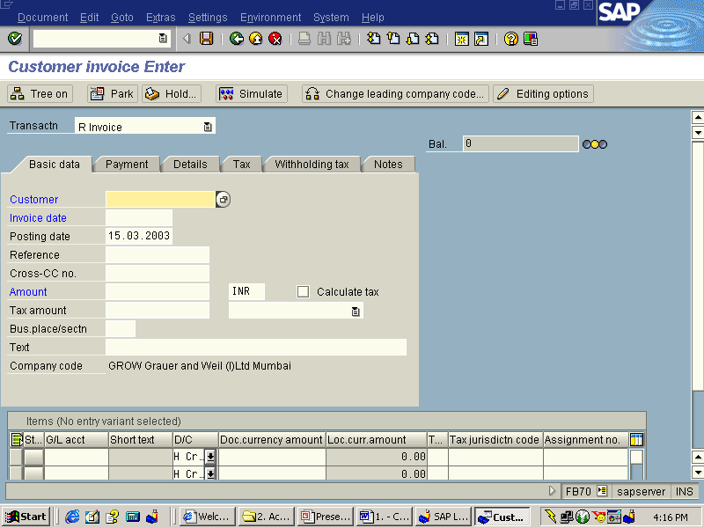
Customer Invoice from FI side
SAP Easy Access → Accounting → Financial Accounting → Accounts Receivable → Document Entry → Invoice.
Transaction Code - FB70

Slide 3
On the Enter Customer Invoice: Header Data screen, enter the following data
Customer Enter Customer Code
Invoice Date Document Date
Posting Date Posting Date
Reference Document Reference
Amount Amount of the invoice
Text Narration
G/L Account To be entered
Amount To be entered
Text Narration
Business Area To be entered
Press Simulate button to see the entry passed
Press Save Button finally to post the transaction
Take note of the Document number for future reference
To display the document posted Press Document → Display or use Transaction FB03 and enter the said document number and press enter.

Slide 4
Customer Credit Memo, Debit Memo from FI side and JV
Credit Memo/ Debit Memo will usually flow from SD Module only for price differences/ goods returns etc., In case a credit /debit memo has to be posted from FI, following documentation may be followed.
Customer Credit Memo
Path
SAP Easy Access → Accounting → Financial Accounting → Accounts Receivable → Document Entry → Credit Memo.
Transaction Code FB75

Slide 5
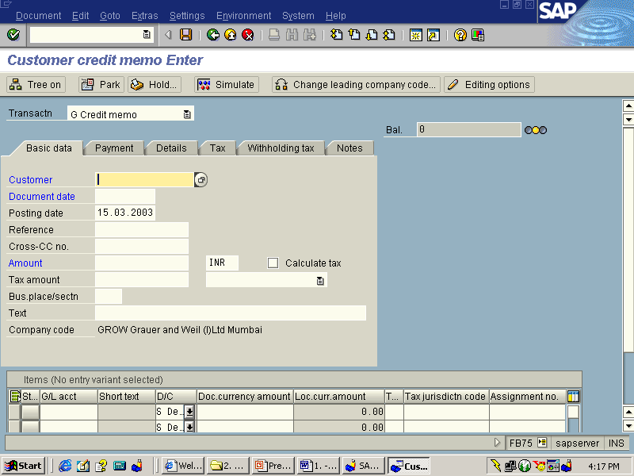

Slide 6
Customer Debit Memo
In the SAP system there is no Concept of Debit Notes Available for either Vendor or Customer. So incase we want to post a Customer Debit Memo from FI side, following route can be followed.
SAP Easy Access → Accounting → Financial Accounting → General Ledger → Document Entry → Others → General Postings.
Transaction Code F-02
Alternatively Transaction Code: FB01 (Post Document ) may also be used.
Main Points
Pstkey 06 (Payment Difference- Customer Debit)
Doc.Type ZD(Customer Debit Memo)

Slide 7
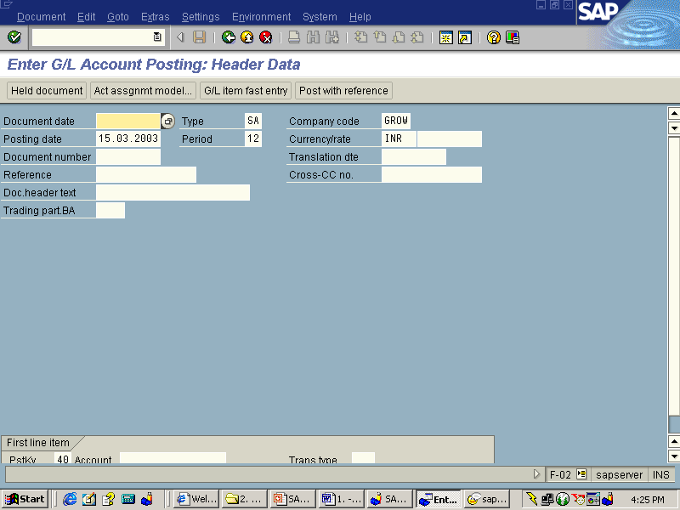
Customer Journal Posting
SAP Easy Access → Accounting → Financial Accounting → General Ledger → Document Entry → Others → General Postings.
Transaction Code F-02

Slide 8
Alternatively Transaction Code: FB01 (Post Document ) may also be used.
Main Points
Doc.Type DA (Customer Document)
Posting key
If customer is to be debited
(Other receivables Customer Debit)
50 (G/L Account Credit)
If customer is to be credited
14 (Other Payables Customer credit)
40 (G/L Account Credit)

Slide 9
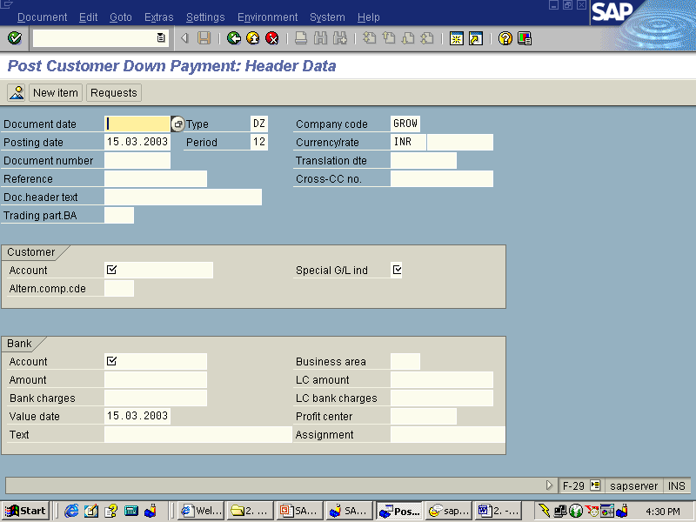
Post Customer Down Payment – Normal
S.NO. : 02- FI-AR- 01
TRANSACTION CODE : F – 29
ACCESS PATH :SAP Easy Access > Accounting >Financial >
Accounting > Accounts Receivable > Document Entry
>Down Payment > Down Payment

Slide 10
We get “ Post Customer Down Payment” Header data” screen ;
Required Fields:
Document date : To be entered
Account : To be entered (Customer A/c Number)
Spl. G/L Ind. : To be set at “A” (down Payment on current asset)
Post date : Default
Amount : To be entered
Rest all other fields viz, Doc Type, Period, Company code,Currency/Rate are default after they are entered for the first time.

Slide 11
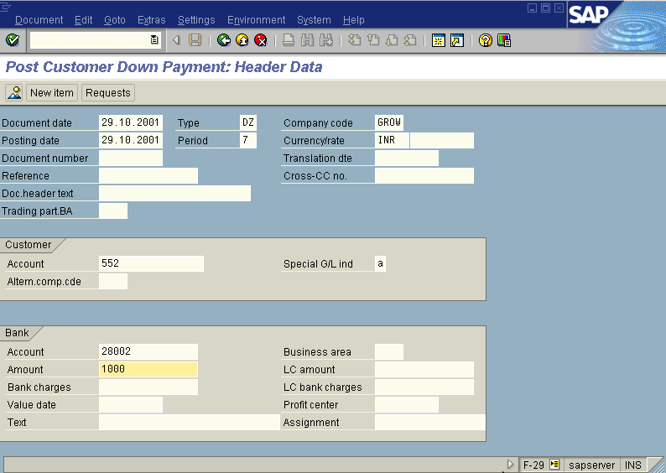
We get the Screen “Post Customer Down Payment - Header Data“ incorporating the above mentioned required fields as under;
Press Enter button

Slide 12
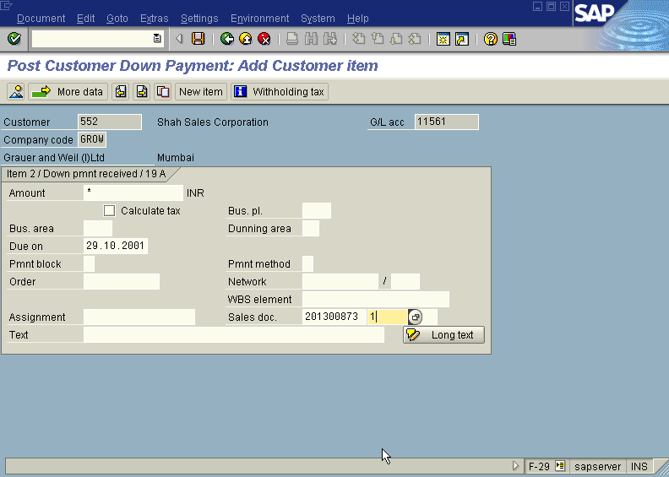
We get the Screen “Post Customer Down Payment - Add Customer Item” as under; where under Amount, Due date, Sales doc. (Sales Order with Line item) fields to be entered.
Press Enter button
This below Screen will change to “Post Customer Down Payment - Correct Customer Item”

Slide 13
The payment block field in the above screen will show “A” (Blocked for payment)
Press Enter button
Press Save button
The system will display a message as under
Take a note of the document number ; 1400086.
This is the stage where “Post Customer Down Payment” stage is complete
The document can be seen from Document Display from the top left hand side of the main screen “post Customer down payment - Header Data“ OR from Transaction code FB- 03 .The Document overview screen will be displayed as under showing the entries.

Slide 14
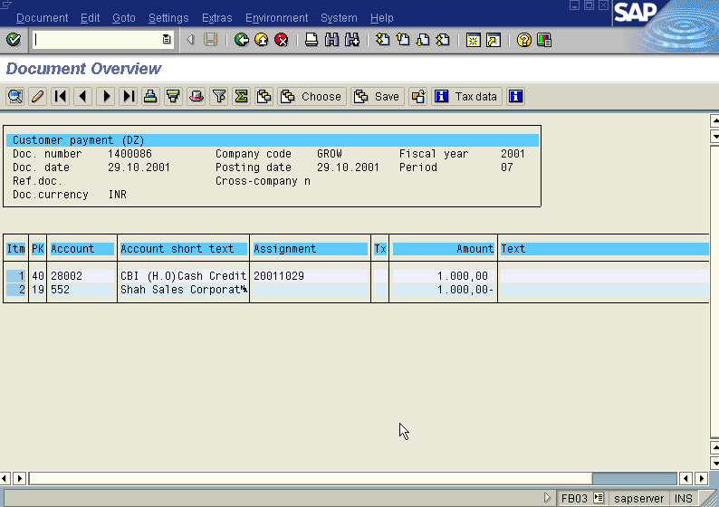

Slide 15
Clear Customer Down Payment
S.NO : 02-FI-AR-02
TRANSACTION CODE : F – 39
ACCESSB PATH : SAP Easy Access- Accounting- Financial Accounting > Accounts Receivable > Document > Entry > Down payment >Clearing
We get “ Clear Customer Down Payment – Header Data” Screen
Required Fields:
Document date : To be entered
Account : To be entered (Customer A/c Number)
Posting date : Default
Fiscal Year : Default
Rest all other fields viz, Doc Type, Period, Company code, Currency/Rate are default after they are entered for the first time
We get the Screen “Clear Customer Down Payment - Header Data“ incorporating the above mentioned required fields as under;

Slide 16
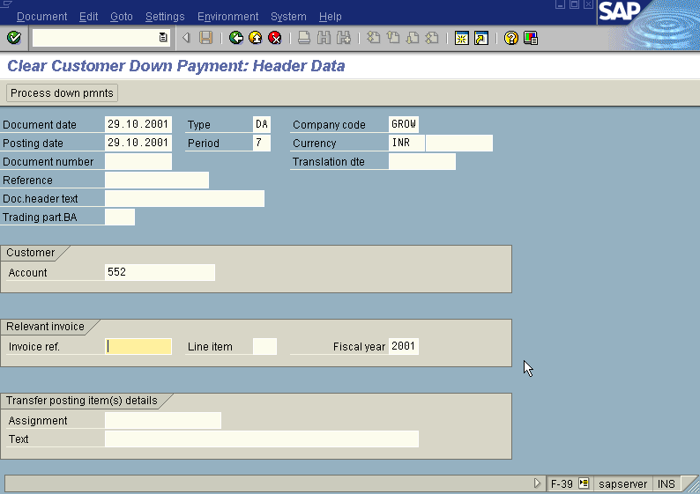

Slide 17
From the above “Clear Vendor Down Payment - Header Data“ screen before pressing enter button one point that has to be kept in mind is deletion of invoice number which is appearing as default under section Relevant invoice in the “Clear Customer Down Payment - Header Data” screen.
Press Enter button

Slide 18
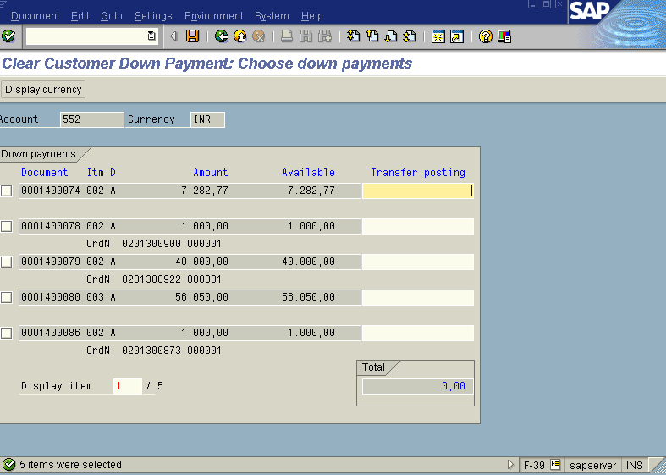
We will be presented with “ Clear Customer Down Payment – Choose Down Payments” screen as below;

Slide 19
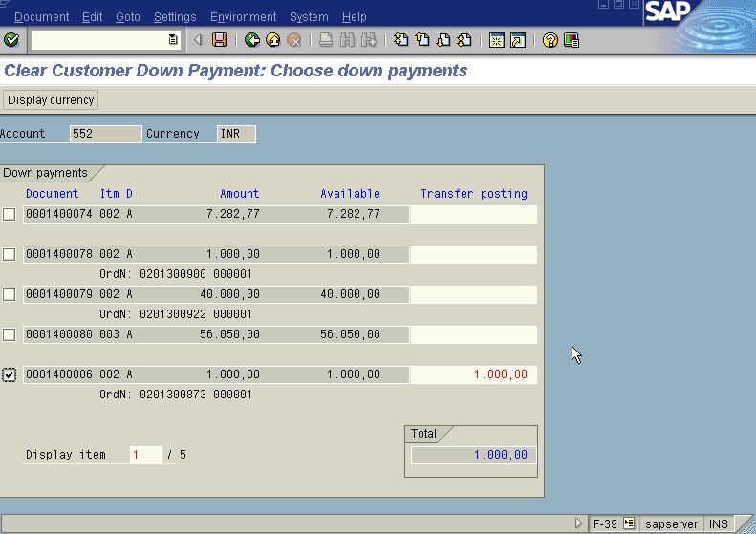
Press Page Down Button from Key board till the point you find the Down payment/s which are to be cleared from the above “ Clear Customer Down Payment – Choose Down Payments” screen. Once you have found the down payment you wanted to clear just put a tick mark on the check box appearing to the left side of down payments list as in the screen shown below;
Press Save button

Slide 20
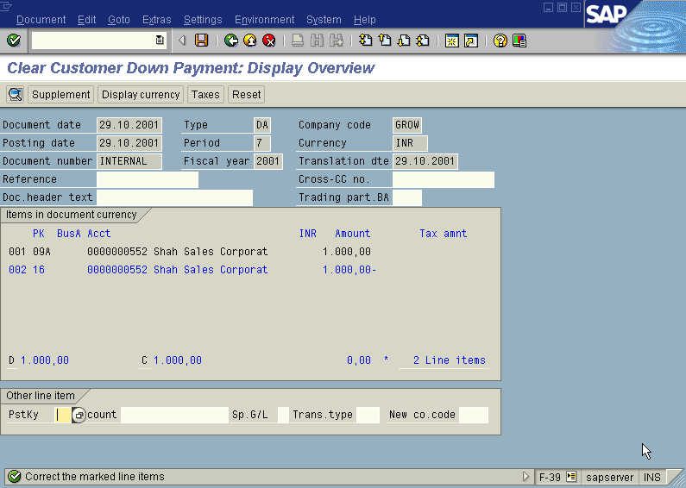
We will get “ Clear Customer Down Payment – Display Overview” screen as below with a message “ correct the marked line items at the bottom with a green tick as below;

Slide 21
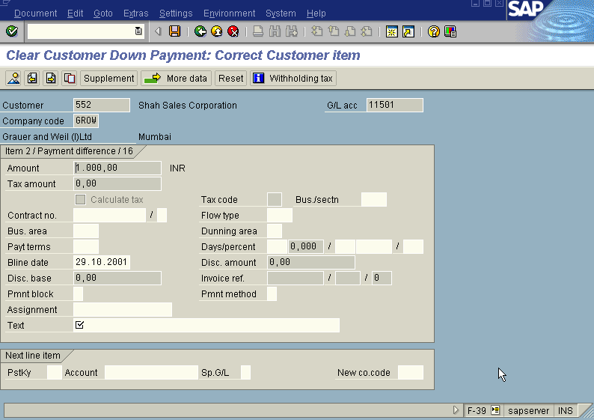
In the above “ Clear Customer Down Payment – Display Overview” screen , just double click with the mouse on the blue colour highlited line item. We will get the
“ Clear Customer Down Payment – Correct Customer Item” screen as displayed below with symbol under Text field.

Slide 22
Fill the Text field with appropriate text in the above “ Clear Customer Down Payment – correct Customer Item” screen.
Press Save button
The system will display a message as under
Take a note of the document number ; 1600075
This is the stage where “clearing Customer down payment” stage is complete

Slide 23
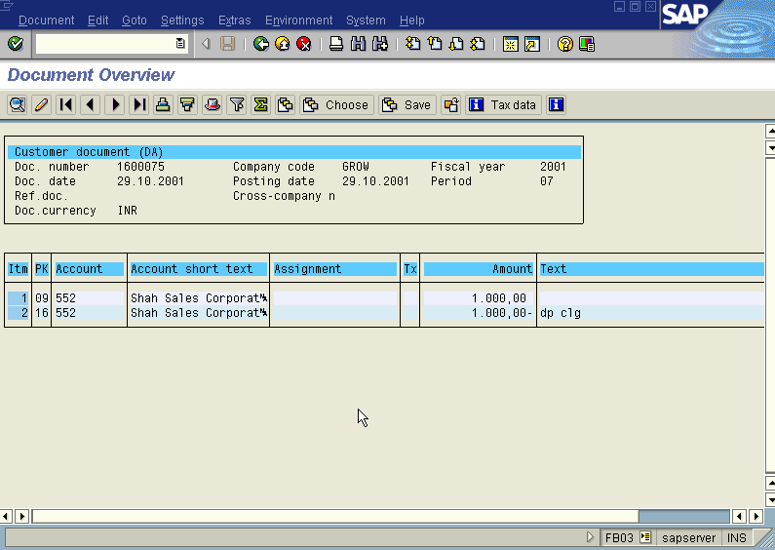
The document can be seen from Document Display from the top left hand side of the main screen “post Customer down payment - Header Data“ OR from Transaction code FB- 03 .The Document overview screen will be displayed as under showing the entries.

Slide 24
Customer Bill of Exchange Payment
S.NO. : 02- FI-AR- 06
TRANSACTION CODE : F – 36
ACCESS PATH :SAP Easy Access> Accounting > Financial Acounting > Accounts Receivable > Document Entry
Bill of Exchange Payment
We get “ Bill of exchange Payment – Header Data” Screen as under;
Required Fields:
Document Date : To be entered
Customer Account : To be entered
Spl. G/L Ind. : To be entered as “B” (Bill of exchange Receivable)
Posting date : Default
Document Type, Currency, Period & Company code appear as default after it has been entered for the first time.

Slide 25
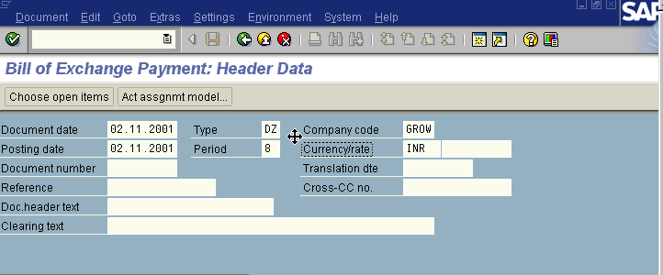
Press enter Button
We get “Bill of Exchange Payment – Add Customer Item” Screen as under
In the above screen fill the amount and due on fields
Press Enter

Slide 26
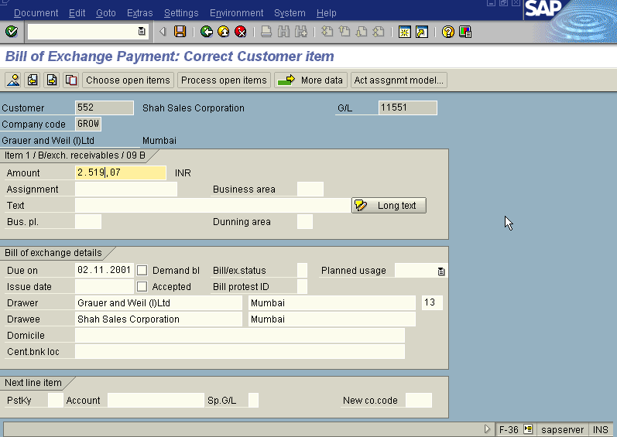
We get “Bill Of Exchange Payment- Correct Customer Item” Screen
As under

Slide 27
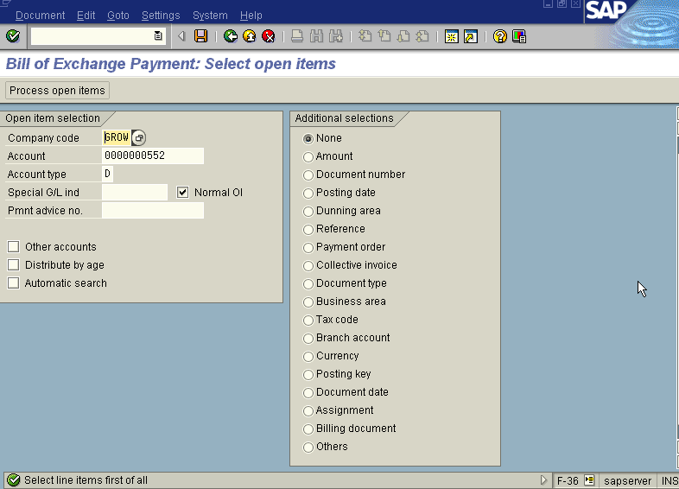
Press Save Button
We get “ Bill of Exchange Payment – Select Open Item” Screen as Under

Slide 28
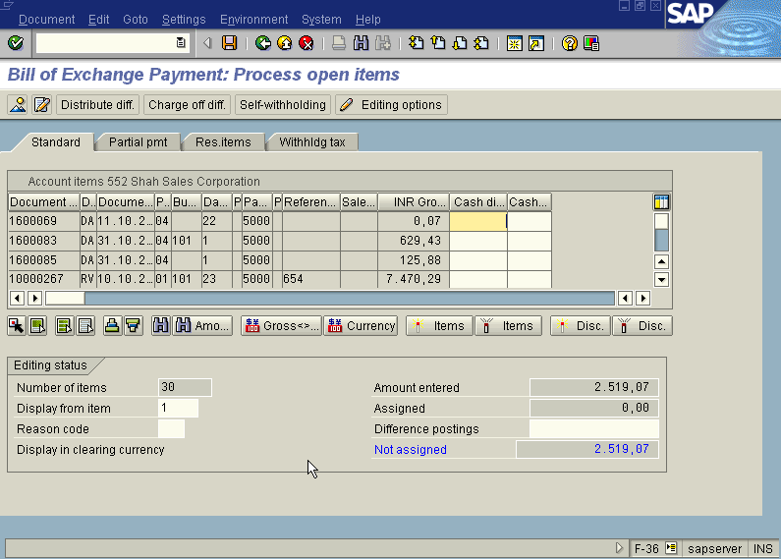
In the above screen Press Process Open Item button
We get “Bill Of Exchange – Process Open Item” Screen as Under

Slide 29
In the above screen first select all Icon, So all the line items will turn blue then press Deactivate Icon so that all the items turn black. Then select the document by scrolling the screen. Once you have found the Document double click on the amount field of that document. Then the Not Assigned field in the above screen turns Zero.
Press Save Button
The system displays the message as under
Take the note of the document number : 1400097.
To view the entries posted go to “Bill of Exchange Payment – Header data” screen
And click Document Display or press Transaction Code FB03.

Slide 30
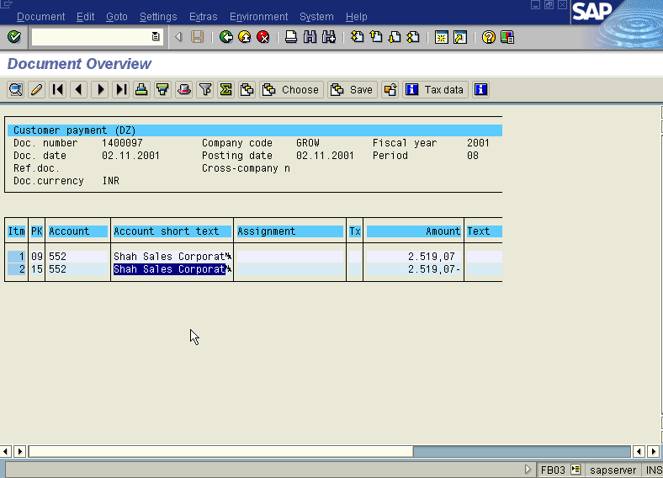
We get the Overview document screen with the entries as under

Slide 31
Customer Bill of Exchange Discounting
Method 1 : Simple
S.NO. : 02- FI-AR- 07
TRANSACTION CODE : F – 33
ACCESS PATH :SAP Easy Access> Accounting -Financial
Accounting> Accounts Receivable> Document Entry> Bill of Exchange> Discounting
We get “ Post Bill of exchange Usage – Header Data” Screen as under;
Required Fields:
Document Date : To be entered
Usage : To be set at “ Discounting”
Bank Account : To be entered
Clearing Account : To be entered (eg: 29501- CBI Bill Discounting A/c)
Amount : To be entered after considering the Discount Charge
Bank Charges : Enter the discount Charges
Posting date : Default
Document Type, Currency, Period & Company code appear as default after it has been entered for the first time.

Slide 32
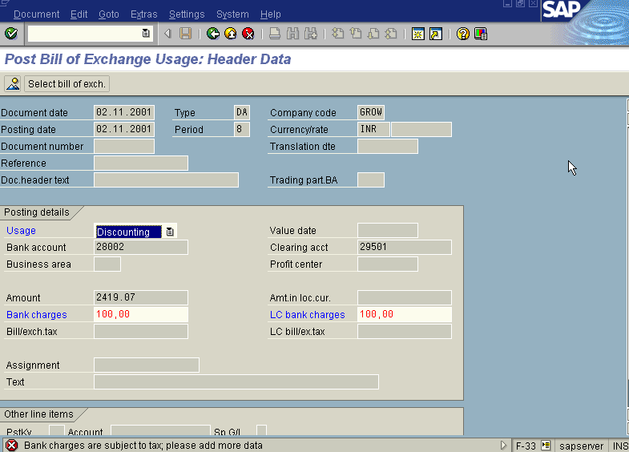
Press enter Button
We get “Tax Data” Screen press Continue Button in this screen twice
Press Select Bill of Exchange Button

Slide 33
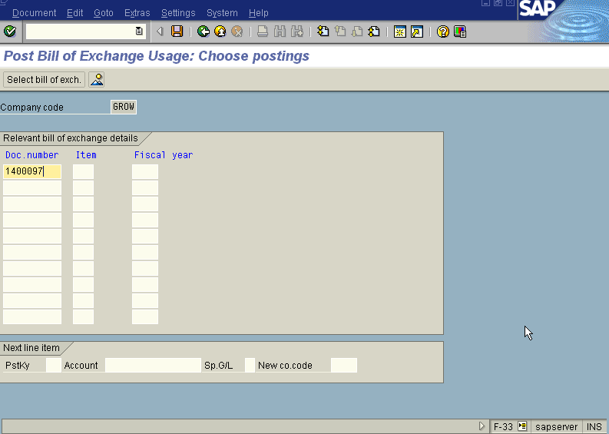
We get “ Post Bill Of Exchange Usage: Choose Postings” Screen as Under

Slide 34
In the above Screen fill the bill of exchange Doc. Number
Press Enter Button
The System Displays the Messsage as under
Press Save Button
The system displays the message as under
Take the note of the document number : 1600090.
To view the entries posted go to “Post Bill of Exchange Usage – Header data” screen
And click Document Display or press Transaction Code FB03.

Slide 35
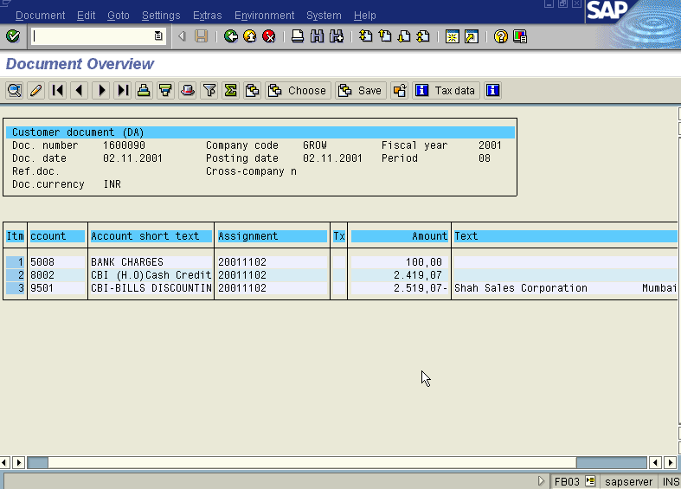
We get the Overview document screen with the entries as under

Slide 36
Customer Bill of Exchange Reverse Contingent Liability
S.NO. : 02- FI-AR- 08
TRANSACTION CODE : F – 20
ACCESS PATH :SAP Easy Access- Accounting- Financial Accounting- Accounts Receivable -Document Entry- Bill of Exchange - -Reverse Contingent Liability
We get “ Reverse Bill Liability – Header Data” Screen as under;
Required Fields:
Document Date : To be entered
G/L Account : Enter (11551 – Bill of Exchange- Domestic Reco. A/c)
Usage : To be set at “ Discounting”
Document No. : To enter the Bill of Exchange document number
Customer Account : To be entered
Posting date : Default
Document Type, Currency, Period & Company code appear as default after it has been entered for the first time.
Press ENTER Button

Slide 37
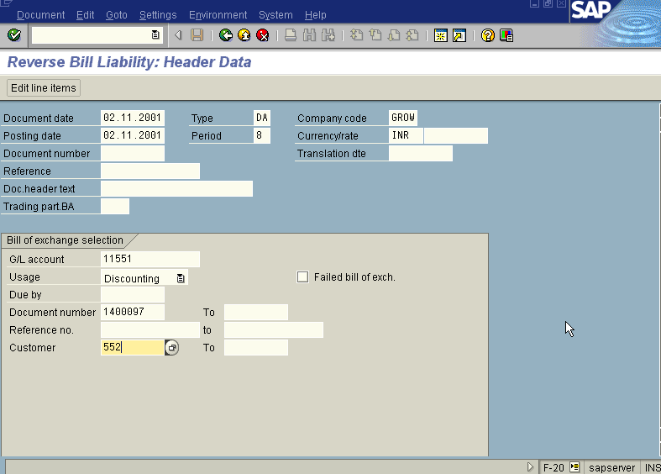

Slide 38
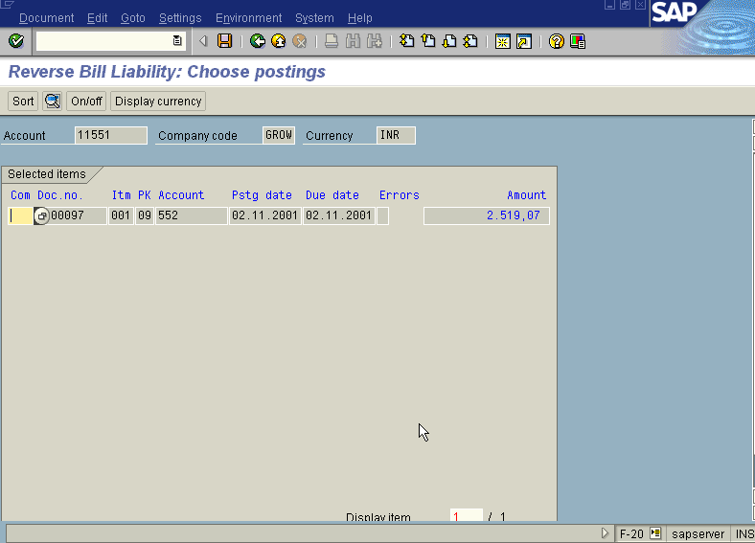
We get “ Reverse Bill Liability – Choose Postings” Screen as under

Slide 39
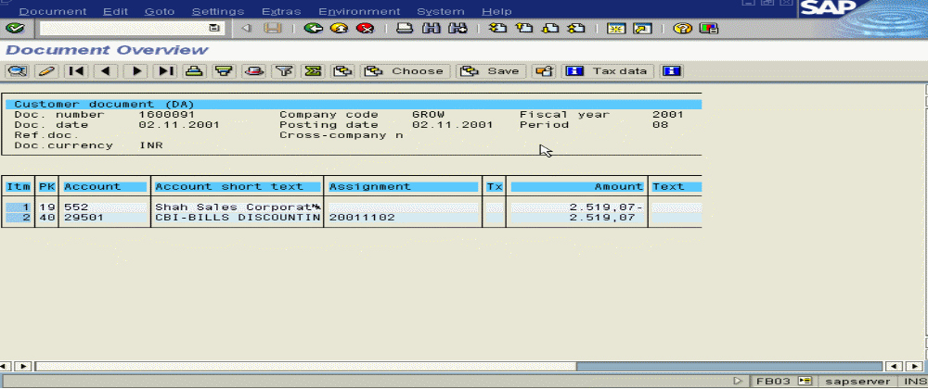
Press Save Button
The system displays the message as under
Take the note of the document number : 1600091.
To view the entries posted go to “Reverse Bill Liability – Header data” screen
And click Document Display or press Transaction Code FB03.
We get the Overview document screen with the entries as under

Slide 40
Method: Post Customer Down Payment - Discount
S.NO. : 02- FI-AR- 04
TRANSACTION CODE : F – 29
ACCESS PATH :SAP Easy Access- Accounting- Financial Accounting- Accounts Receivable - Document Entry - Down Payment-Down Payment
We get “ Post Customer Down Payment” Header data” screen ;
Required Fields:
Document date : To be entered
Account : To be entered (Customer A/c Number)
Spl. G/L Ind. : To be set at “A” (down Payment on current asset)
Post date : Default
Amount : To be entered
Rest all other fields viz, Doc Type, Period, Company code,Currency/Rate are default after they are entered for the first time.
We get the Screen “Post Customer Down Payment - Header Data“ incorporating the above mentioned required fields as under;
Press Enter Button

Slide 41
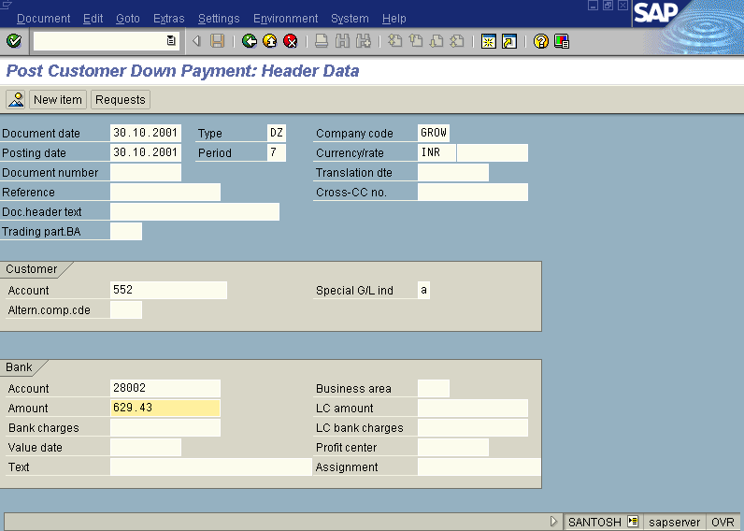

Slide 42
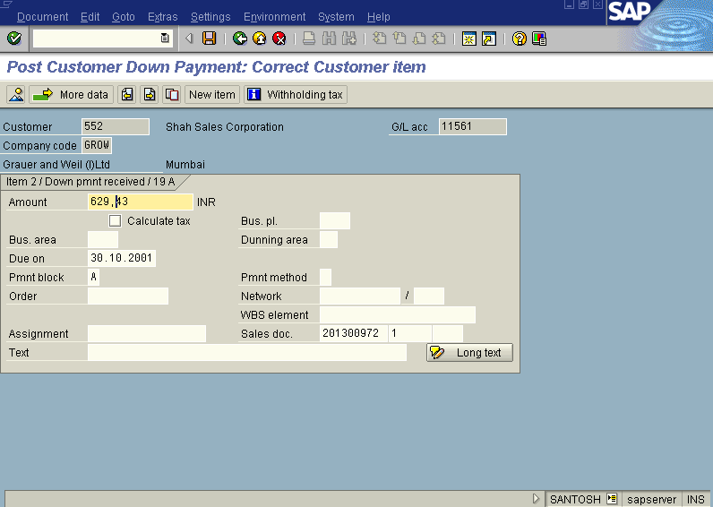
We get the Screen “Post Customer Down Payment - Add Customer Item” as under; where under Amount, Due date, Sales doc. (Sales Order with Line item) fields to be entered.

Slide 43
Press Enter button
This above Screen will change to “Post Customer Down Payment - Correct Customer Item”
The payment block field in the above screen will show “A” (Blocked for payment)
Press Enter button
Press Save button
The system will display a message as under
Take a note of the document number ; 1400087.
This is the stage where “Post Customer Down Payment” stage is complete
The document can be seen from Document Display from the top left hand side of the main screen “post Customer down payment - Header Data“ OR from Transaction code FB- 03 .The Document overview screen will be displayed as under showing the entries.

Slide 44
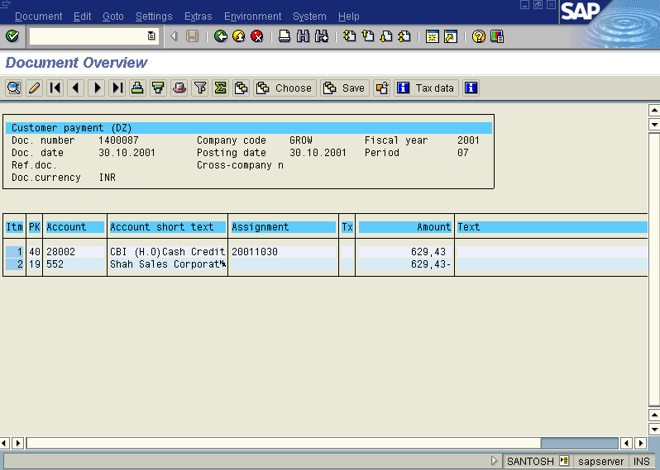

Slide 45
S.NO. : 02- FI-AR- 05
TRANSACTION CODE : F – 30
ACCESS PATH :SAP Easy Access – Accounting -Financial Accounting- Accounts Receivable - Document Entry- Other Int.Trf Posting - With Clearing
We get “Post With Clearing- Header data” screen ;
Required Fields:
Document date : To be entered
Account : To be entered (Customer A/c Number)
Posting Key : To be set at “08” ( Payment Clearing)
Post date : Default
Rest all other fields viz, Doc Type, Period, Companycode,Currency/Rate are default after they are entered for the first time.
We get the Screen “Post with Clearing - Header Data“ incorporating the above mentioned required fields as under;
Press Enter Button

Slide 46
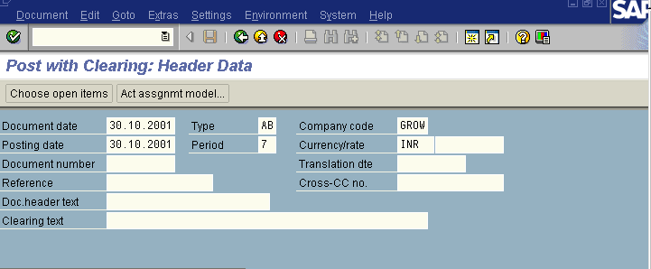
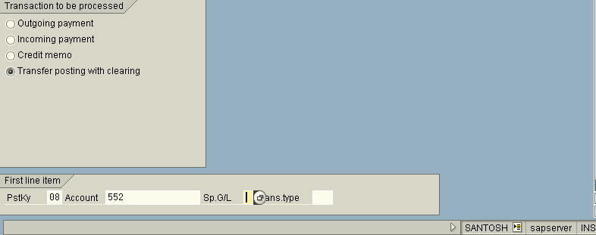

Slide 47
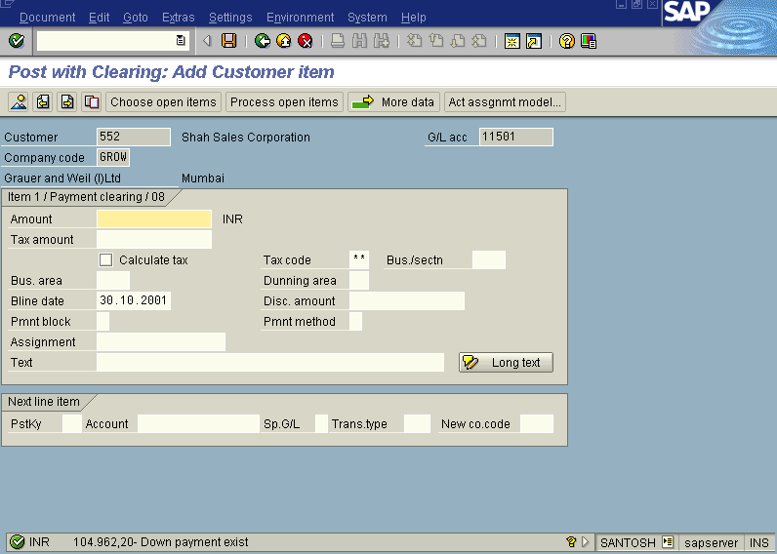
We get the Screen “Post With Clearing - Add Customer Item” as under; where nothing has to be entered.

Slide 48
Press Enter button
The system will display the warning message as under
“Amount is Zero-Line item will be ignored”
Press Process Open Item button
We get “Post with clearing – Select open items” Screen as under

Slide 49
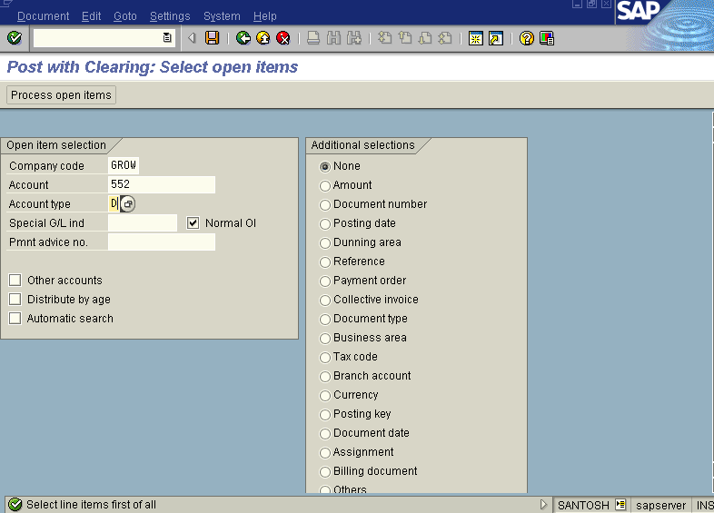
Press Process Open Item button

Slide 50
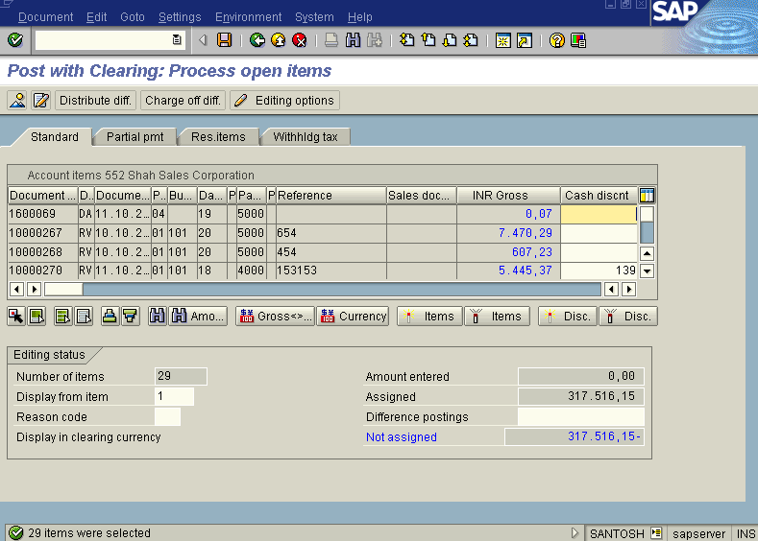
We get “Post with clearing – Process open items” Screen as under

Slide 51
In the above screen first press icon select all so that all the items get selected and turns blue. Then press icon Deactivatate so that all items in blue turns black. Now select the invoice document and the downpayment down document so as to make the as make the above screen will display in the not assigned portion the discount amount.
Press Save Button
The System displays the message as under
Document 1600076 was posted to company code GROW
Take note of the above number eg: 1600076 in this case
The document can be seen from Document Display from the top left hand side of the main screen “post Customer down payment - Header Data“ OR from Transaction code FB- 03 .The Document overview screen will be displayed as under showing the entries.

